Slide 1

Mini project Presentation SESSION 2021-22
Department of Computer Science
ABES Engineering College, Ghaziabad, UP
Team Name :Classifier
Class & Section :Computer Engineering
Member Name University Roll No Admission No
Shubham Mall 1900320150054 2019B151049
Shakshi Sah 190320310133 2019B111063
Ritu Chaturvedi 1900320150041 2019B151012

Slide 2
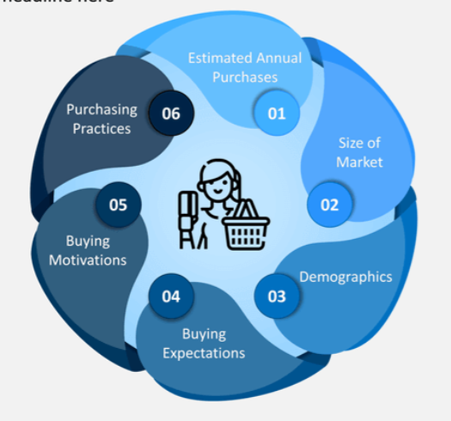
Objective
Discover insight into consumer review and assist with ml models
Training ml model for sentiment analysis
Analyse customer review for positive and negative reviews
Analysing the rating patterns through graph

Slide 3
Dataset info -
The dataset is downloaded from data source: https://www.kaggle.com/sid321axn/amazon-alexa-reviews/kernels and contains nearly 3000 reviews of rows and 5 variables which are-
Star ratings
Date of review
Variant
Verified review
feedback

Slide 4
Sentiment analysis
Sentiment analysis is the measurement of positive and negative language. Sentiment analysis is also known as opinion mining.
It is a way to evaluate written or spoken language to determine if the expression is favourable or neutral to what degree.
It uses data mining process and technique to extract anc capture data for analysis in order to discern the subjective opinion of a object.

Slide 5
methodology
Research statement | “A study of Consumers satisfaction analysis with respect to Amazon Alexa review”
Project type | Descriptive and analytical
Sampling unit | Urban areas customer
Tools and technology used | Notebook – Jupiter notebook Python libraries – NumPy, pandas ,seaborn ,matplotlib ,sklearn.naivebase classifier

Slide 6
Project description
The Project focus on classifying the group of customer into positively rated and negatively rated area.
Positive and negative are marked with 1 and 0 respectively.
Positive if rating >=3
Negative if rating < 3
Creating a frequency count of the words removing unwanted parts by filtering stopword and punctuation by nltk.corpus.

Slide 7
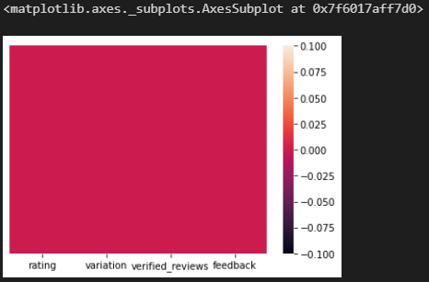
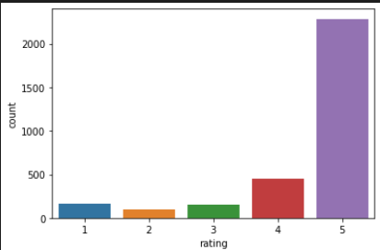
Data analysis and interpretation
It is observed that there are no negative or null data element in the dataset
The frequency count of 5 star customer is nearly 2600 and least rating 1,2 star is less than 500.

Slide 8
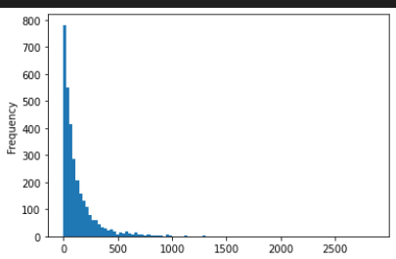
The reviews provided by the users are in combination of sentence and emojis.
Maximum of the users give reviews of word length of nearly 700 – 800
Very few of the users give reviews in like > 1000 length of words(4 or 5).

Slide 9
Removing unwanted words and symbols
def message_cleaning(message):
test_punc_removed = [x for x in message if x not in string.punctuation]
test_punc_removed_join = ''.join(test_punc_removed)
test_punc_removed_join_clean = [word for word in test_punc_removed_join.split() if word.lower() not in stopwords.words('english')]
return test_punc_removed_join_clean
This function takes the reviews in sentence and remove punctuation and extra words which are not required using the stopwords.word(‘English’) and return it in a list and the filtered list is used for the generation of count word list using countvectorize.toarray() method which will work as the input for test data.

Slide 10
conclusion
By analysing the dataset we can give potential customer a clear understanding of the product by providing them the review of those customer who already have Alexa
Using sklearn.naive_bayes classifier machine learning algorithm shows that the frequency of 5 star is much grater and frequency of 2 star or less is very low and the predicting the rating of next upcoming customer with accuracy of 83%.

Slide 11
Future scope
Sentiment analysis can be Beneficial for e-commerce Business.
Benefit for consumers and company relationship.
1. Establishes more trust between Customer and Company.
2. Give consumer a voice to respond.
References
Sentiment analysis of online product Review with Semi-supervised Topic sentiment mixture model , Qingling Miao Qiedin Li.

Slide 12
THANK YOU

